Slide 1
Yellowtail Umbilical INDEPENDENT STUDY
Aker Solutions & ExxonMobil
Design Review

Slide 2
Activity Kongsberg Maritime SOW
Review of Aker Solutions reports (ongoing)
Extreme Strength (Preliminary presented today)
Wave Fatigue (HOLD)
Local Uflex analysis (Preliminary presented today)
VIV fatigue (Preliminary presented today)
Interference analysis (HOLD)
Project owner: Rune Haakonsen
Project Manager: Joao Pedro
QA: Ole Ravneberg
VIV: Sue Bao
Strength: Manohar Varadhi

Slide 3
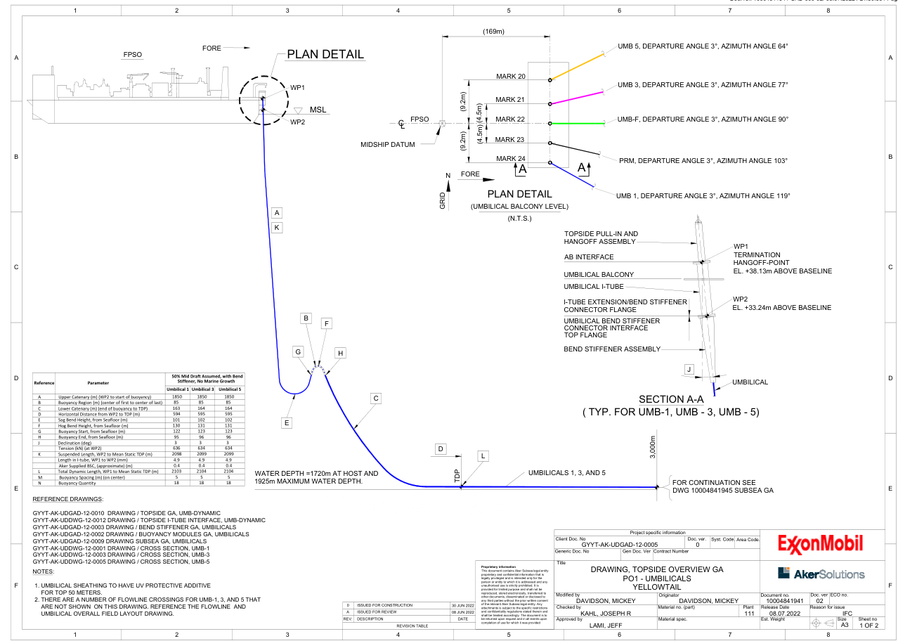
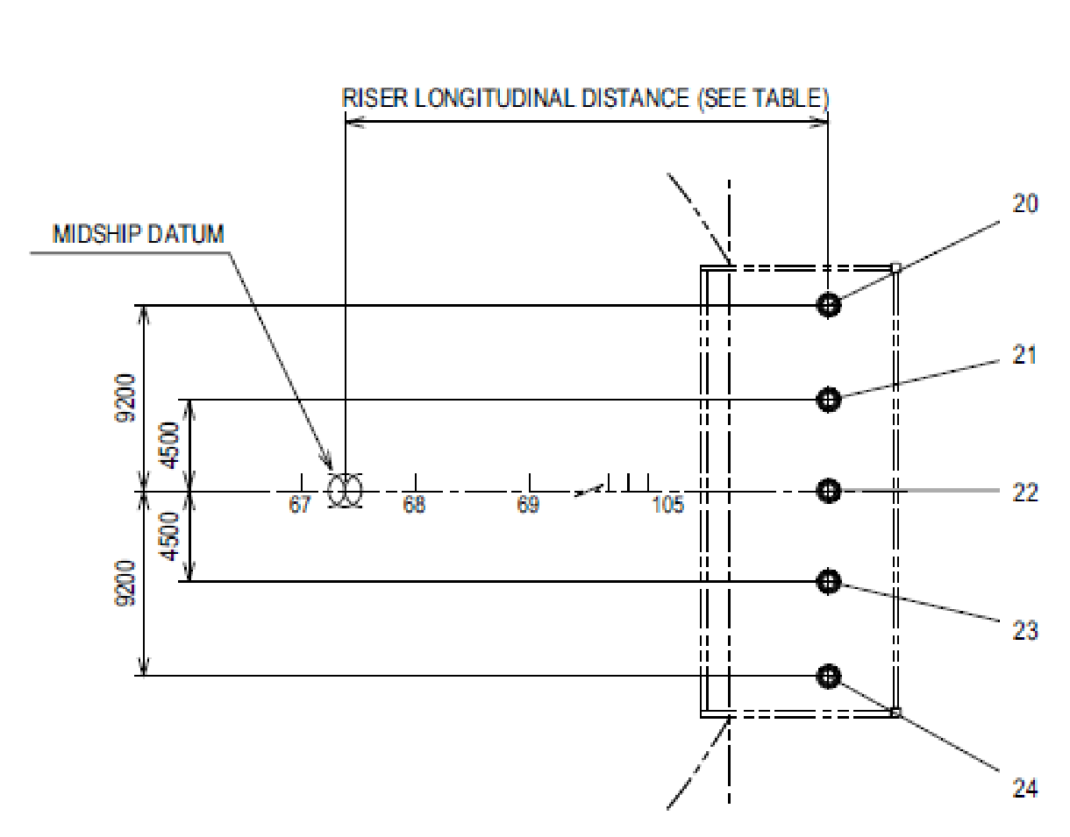
Global Configuration Static Benchmark
Overview
Umb-1 is chosen out of the three Umbilicals for third party verification study.
Heavier umbilical, max acceleration are the reasons.
UMB-1

Slide 4
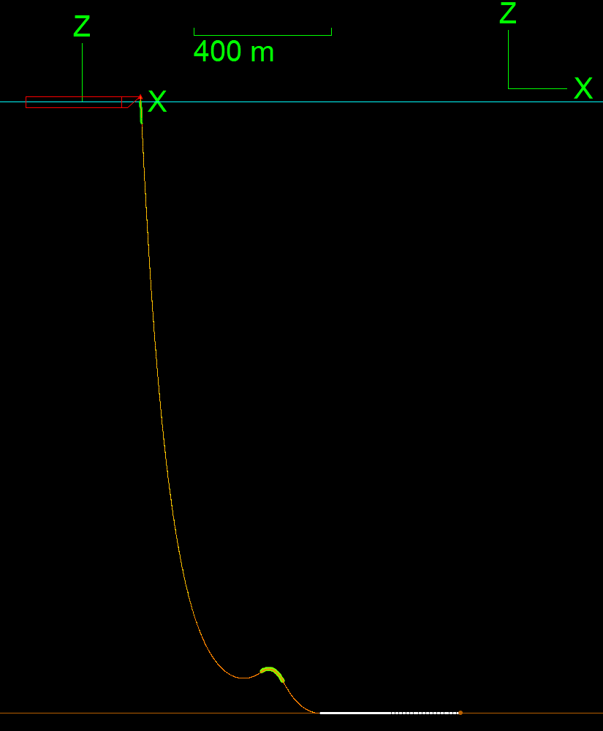
Global Configuration Static Benchmark
Global Configuration Static
Static comparison benchmark with Aker global model results is performed for umbilical 1
Static results are in good match.
UMB-1
Parameter | 50% Mid Draft Assumed
 | Aker | Kongsberg
Upper Catenary (m) | 1850 | 1850
Net Uplift EOL (Tons) | 11.16 | 11.16
Horizontal Distance from WP2 to TDP (m) | 597.8 | 599.3
Model Length from Hang-off to End B(m)⁽¹⁾ | 3094.6 | 2565.3
Sag Bend Height, from Seafloor (m) | 101 | 101.6
Hog Bend Height, from Seafloor (m) | 127.9 | 128.5
Declination (degree) | 3 | 3
Tension (kN) | 632.5 | 642
Suspended Length, BS Flange to Mean Static TDP (m) | 2098 | 2100.2
1) Reduced length on seabed

Slide 5
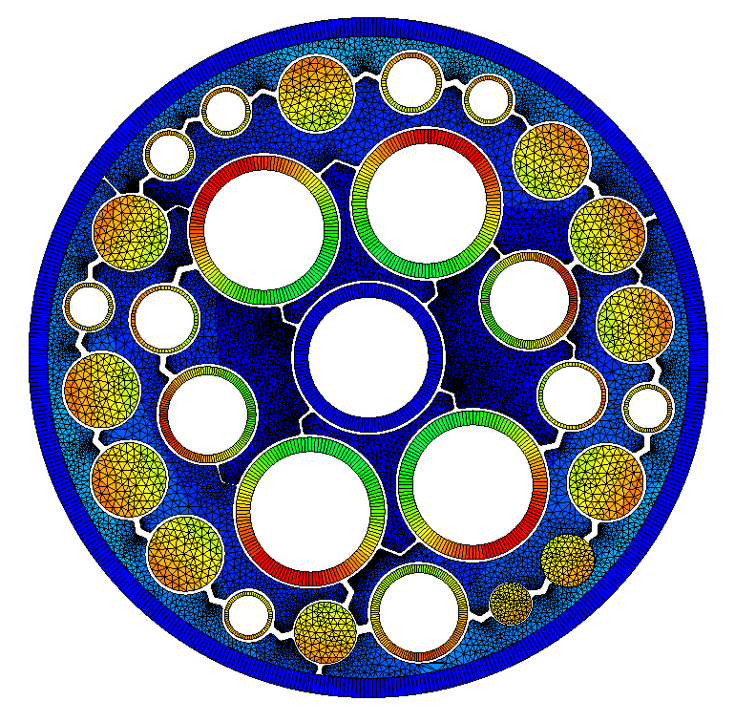
Local Configuration
UFLEX 2D Model – Input Data
Kongsberg developed Aker Cross-section model using Uflex v2.8.9.
Required input was extracted from Aker Umbilical datasheet and CAD model.
Only steel tubes are analyzed as part of the scope.
Friction coefficient between the components were provided from Aker
Tube to PVC =0.25
Cables to PVC = 0.2
Sheath to PVC = 0.09
Gap between the components and fillers is typically 1mm.
Fiber optical cables and Electrical cables are modelled as beam with linear material model (representative).

Slide 6
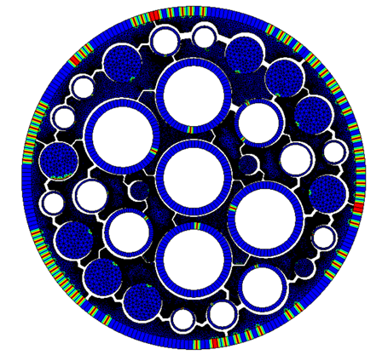
Local Configuration
UFLEX 2D Model – Input Data
Contact model to the right showing the tubes moving radially inwards when full pressurized and applied top tension.
End cap with maximum internal pressure in all the tube is 584 kN.
Good match on the cross-section properties comparison.
Parameter | EA [ MN ] | EI [ kNm² ] | GI [ kNm² ]
Aker | 846 | 206 | 158
Kongsberg | 905 | 237 | 138
Tubes | ID | t | OD | Quantity | Int.Pres | End Cap
 | [mm] | [mm] | [mm] | - | [ Mpa ] | [ kN ]
1.5in Center Tube | 38.1 | 4 | 46.1 | 1 | 69.00 | 78.67
1.5in Tube (Lay 1) | 38.1 | 4 | 46.1 | 4 | 69.00 | 314.67
1in Tube | 25.4 | 3.34 | 32.1 | 3 | 69.00 | 104.89
3/4th Inch | 19.05 | 1.1 | 21.25 | 2 | 34.50 | 19.67
5/8th Inch | 15.88 | 1.54 | 18.96 | 1 | 69.00 | 13.67
1/2in Tube | 12.7 | 1.23 | 15.16 | 6 | 69.00 | 52.44
 |  |  |  | 17 |  | 584.00

Slide 7
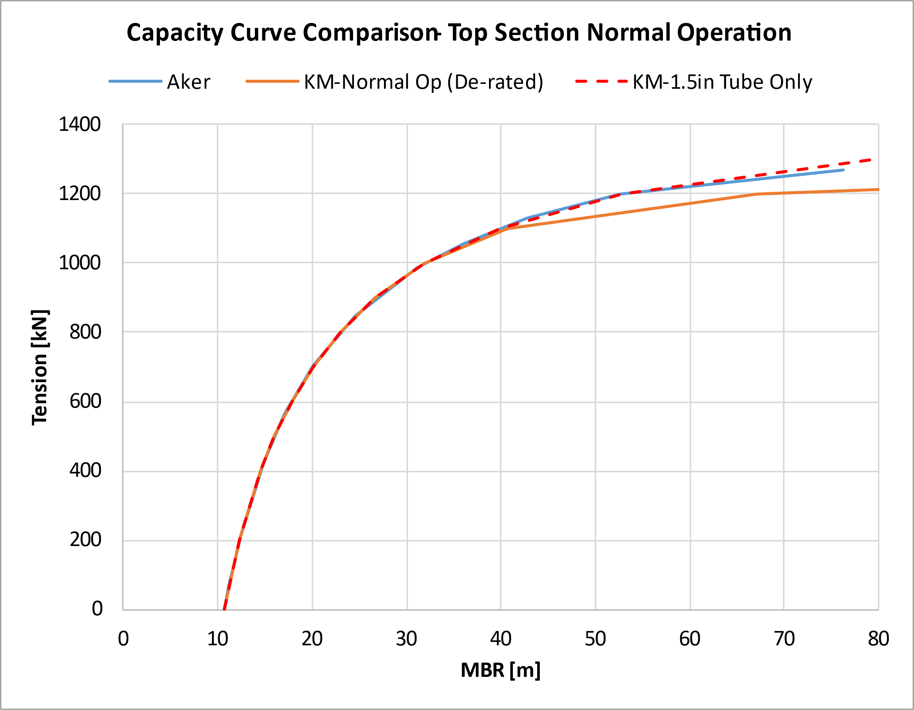
Capacity Curve Check
Results and Comparison
Kongsberg performed capacity check using API 17E (ISO 13628-5:2009).
Operation temperature at 60ºC is considered. SMYS at 20º C is 680 MPa. Derating of yield stress on a 1.33 MPa reduction in SMSY for every 1ºC is considered as per Aker DB.
The difference at higher tensions is because, Aker solutions capacity curve is only based on 1.5in Tube (see red curve considering only KM curve) and KM considers all the tubes when developing combined capacity curve (1.0in tube is critical for high tension).
Electrical components are not included in the capacity check study. Load sharing of the electrical cables is estimated to be very low since axial stiffness is driven completely by tubes.
1.0in Tube

Slide 8
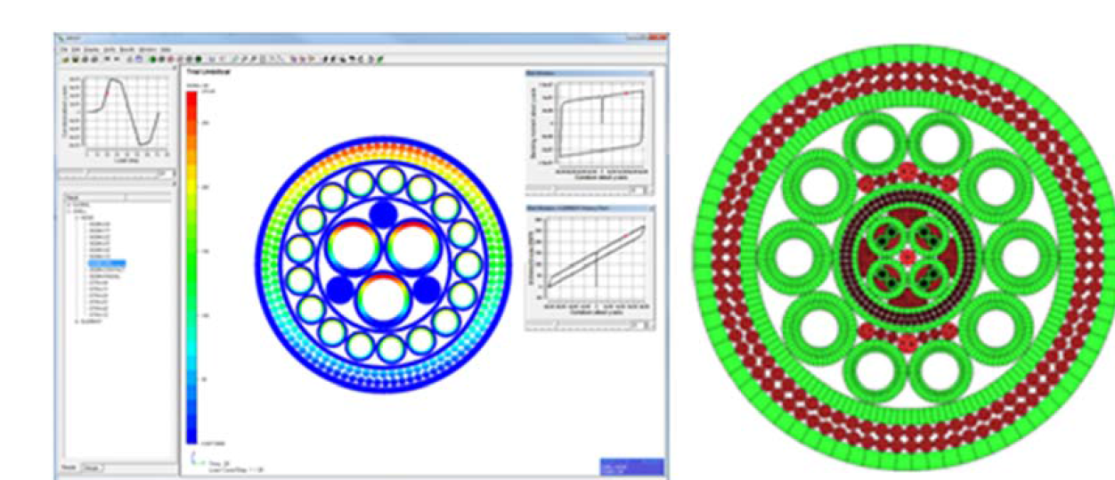
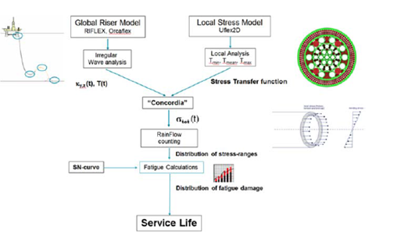
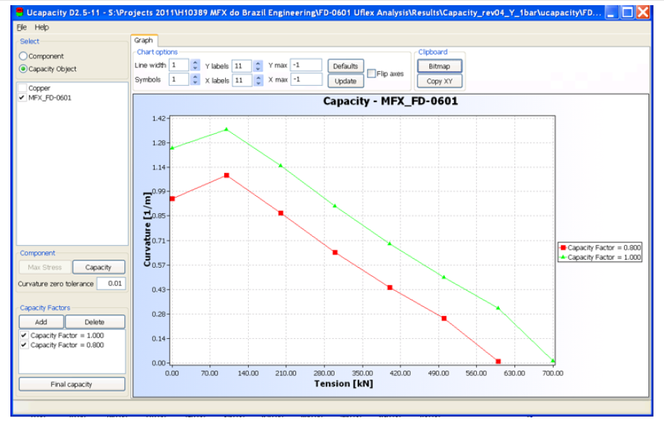
Strength and Wave Fatigue Methodology
Strength «UCAPACITY»
Wave Fatigue «CONCORDIA»
Time domain Irregular wave. Curvatures and Tension time series will be used as direct input for local cross-sectional analysis using Uflex 2D and Concordia.

Slide 9
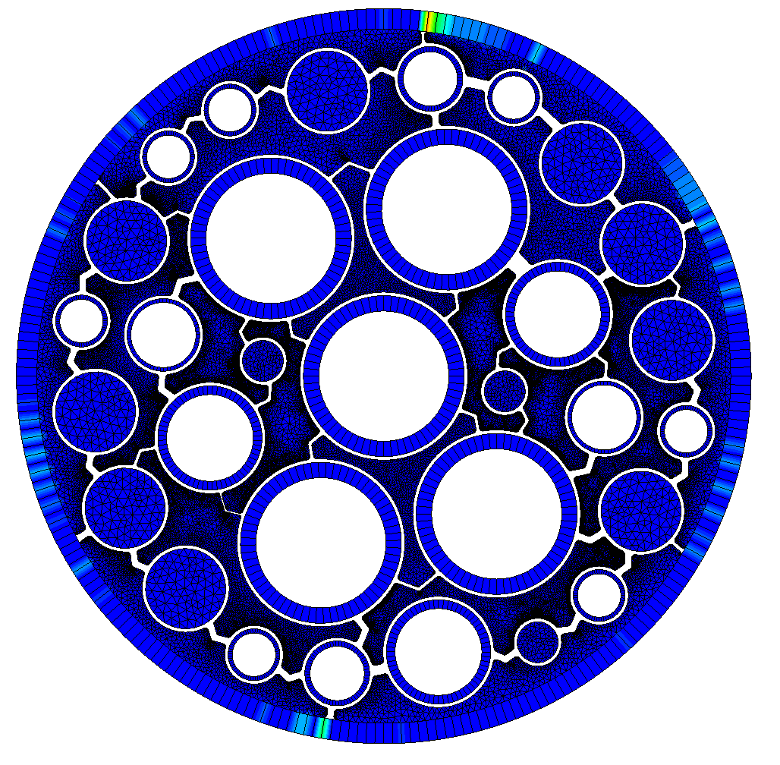
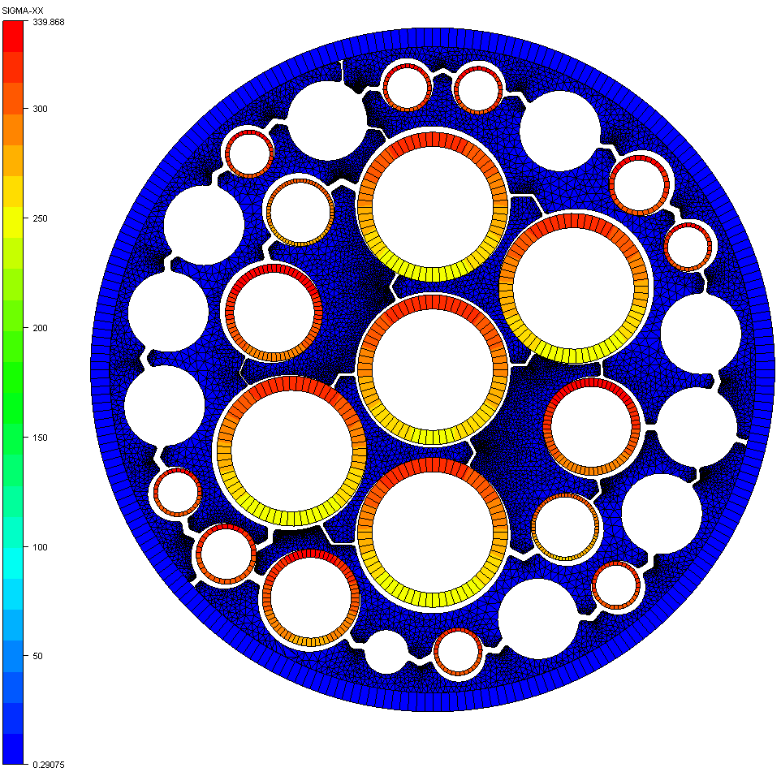
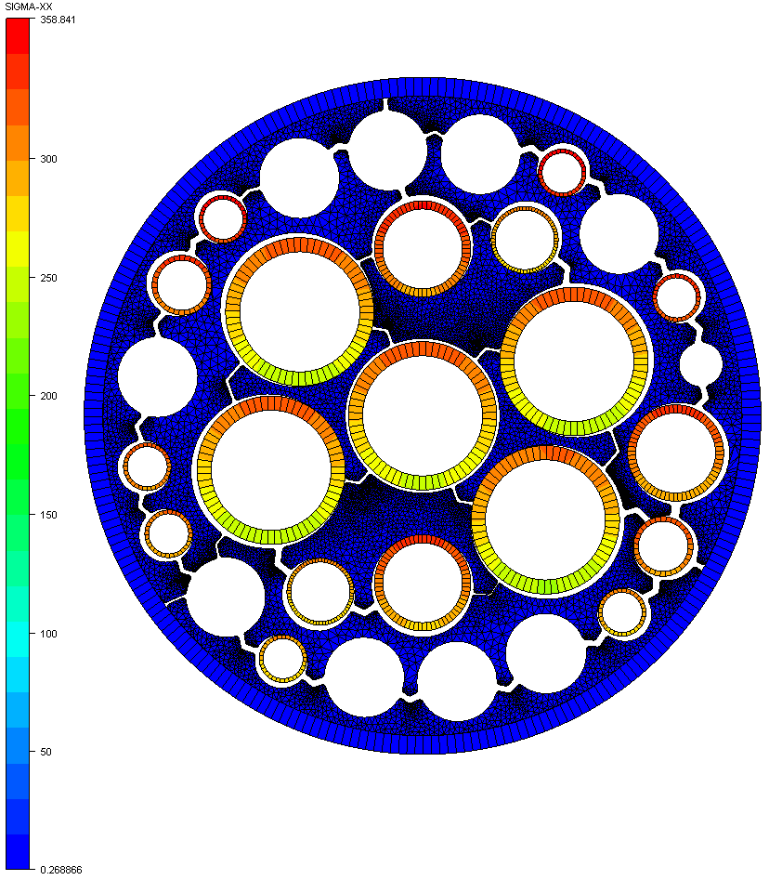
Wave and VIV Fatigue
Local Analysis | Stress Factors
Stress Factors are prepared for different tension ranges covering the global fatigue analysis. These are used as input for the fatigue analysis in Concordia.
Cross-sections are oriented to be lined in stiff load path, where maximum contact pressure is expected and stress factors are extracted from the worst node.
Base Model
1.5 in Tube - Model
1.0 in Tube - Model

Slide 10
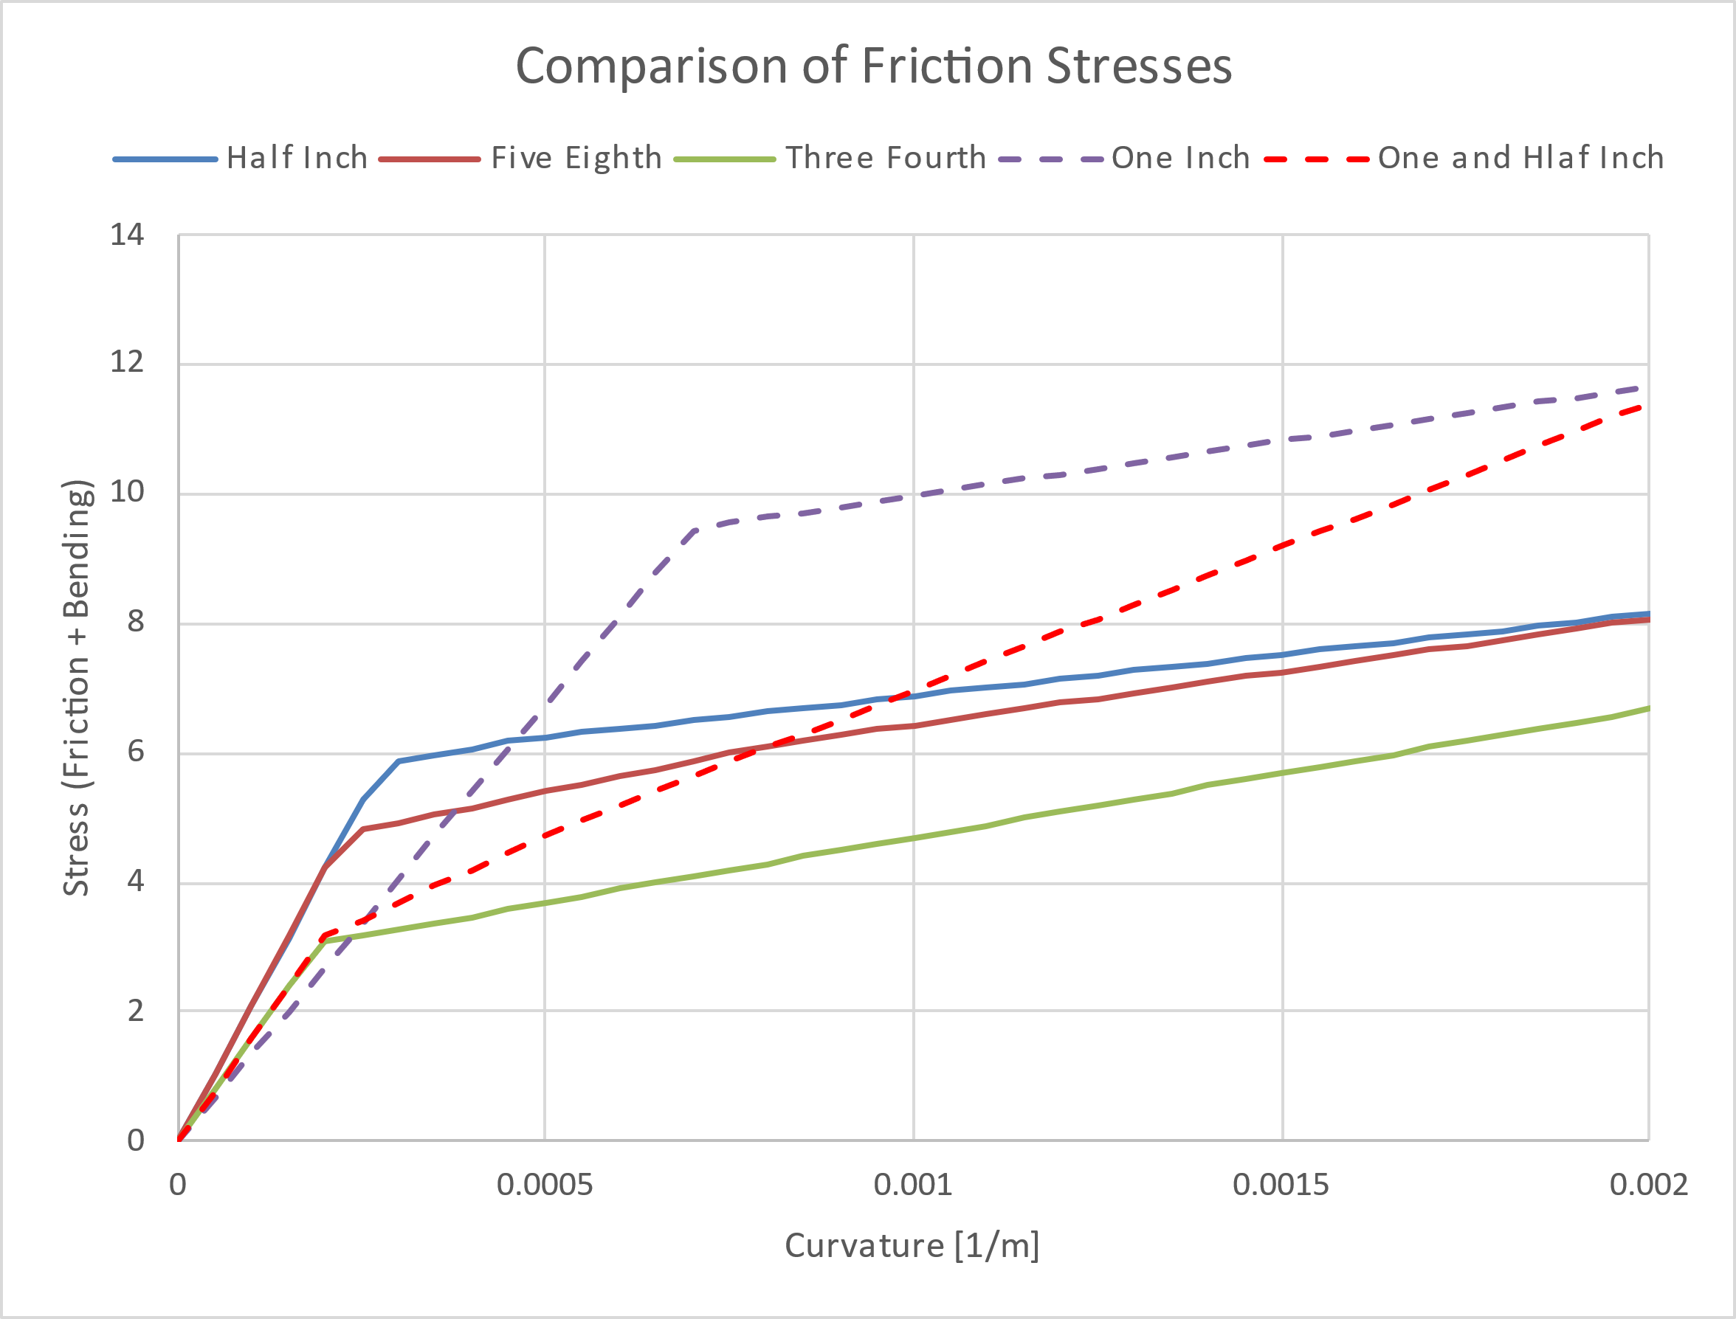
Wave and VIV Fatigue
Local Analysis | Stress Factors
Stress factors are extracted for both bottom and top section.
One-inch tube had higher friction stress compared to other tubes in the bend stiffener region.
In the buoyancy region, 1.5in tube dominates.
Fatigue analysis was performed on one and half inch tube.
Checks will be performed on one-inch tube will be checked to
Other tubes are not critical based on stress factors evaluation.

Slide 11
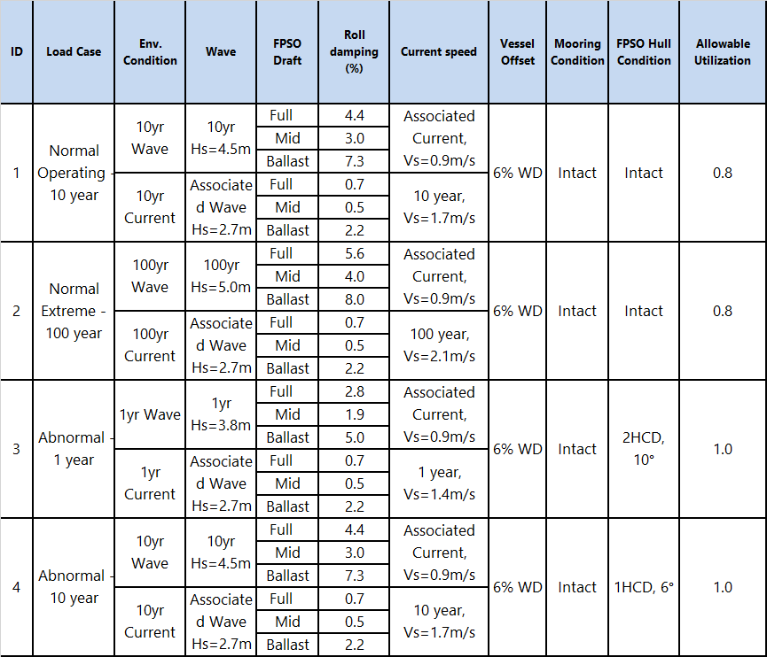
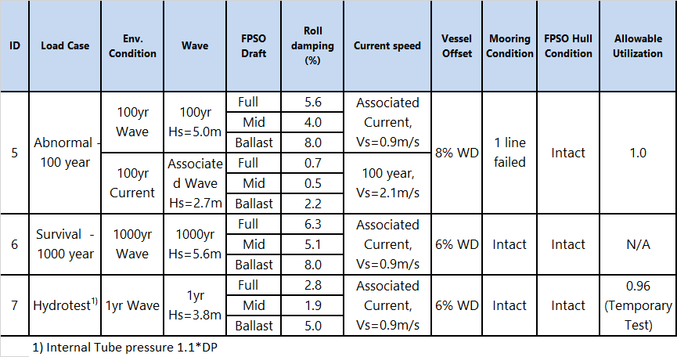
Strength Load Case Matrix Review
Load Case Table
The loading condition matrix to be analyzed
The screening identifies critical FPSO draft, Hs-Tp and wave heading. T_{p} +/- 10% will be considered.
Wave heading fixed and Current and Offset applied Co-Linear in NEAR/FAR/CROSS/TRANSVERSE directions

Slide 12
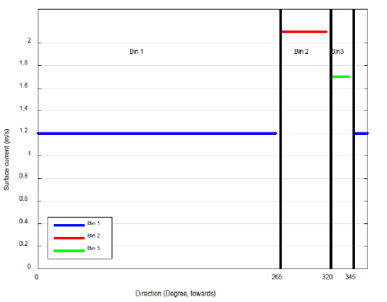
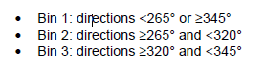
Load Case Matrix Review
Environmental input
Sea states in sector 0deg (from north) to 90deg (from east) from north are considered in the Extreme Analysis.
Wind sea (low Tp) and Swell (high Tp) will be treated independently
For extreme analysis, a Tp=+/-10% was considered
Associated current =0.9m/s (surface) for 1 to 1000-year wave cases
For 1 to 100-year current cases, associated wave is Hs=2.7m (95% NX).
Directional current profiles are used for extreme current cases
10% velocity is added from 200m below WL and below
Return period | Hs | T_{p1} |  |  | T_{p2} |  |  | Gamma1 | Gamma2
 |  | low | mean | high | low | mean | high
 | [m] | [s] | [s] | [s] | [s] | [s] | [s] | [-] | [-]
1 year | 3.8 | 8.7 | 9.7 | 10.7 | 14.9 | 16.5 | 18.2 | 2 | 8
10 year | 4.5 | 9.5 | 10.6 | 11.7 | 16.2 | 18 | 19.8 | 2 | 8
100 year | 5 | 10.1 | 11.2 | 12.3 | 17.2 | 19.1 | 21 | 2 | 8
1000 year | 5.6 | 10.6 | 11.8 | 13 | 18.3 | 20.3 | 22.3 | 2 | 8

Slide 13
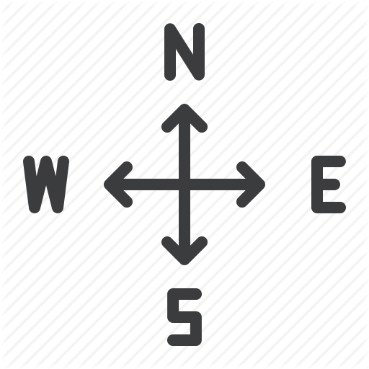
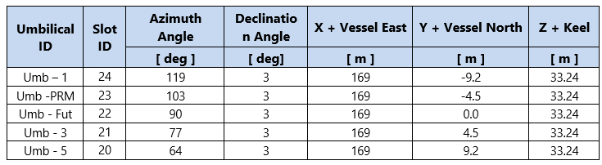
Load Case Matrix Review
Strength Analysis| Load case definition
High wave event in sector 0deg to 90deg from bow (including beam sea 90deg).
UMB-1 is picked for full analysis (heaviest umbilical and has max hang off acceleration based on screening)
90deg
75deg
67.5deg
45deg
UMB-5
22.5deg
Wave 0-90deg from bow
UMB-3
0deg (head sea)
UMB-1
UMB-1

Slide 14
Load Case Matrix Review
Strength Analysis| Load case definition
From RAO/wave screening, critical wave direction is:
Max Tension/Acceleration cases: 90deg from bow (from North)
Max Curvature/Rotation cases: 75deg beam sea (from North)
Wave heading fixed for all scenarios (NEAR/FAR/CROSS/ TRANSVERSE)
Current and Offset applied in NEAR/FAR/CROSS/TRANSVERSE directions
Note, based on experience, there are typically no correlation between wave direction and current direction (from other fields).
Since weather is dominantly from east, max offset is expected in west/northwest direction
90deg from bow (max Curvature/Rotation)
Beam Sea 75deg (max Tension/acceleration)
Offset and Current directions
GA03a – 03d: CROSS
119°
UMB-1
GA04a – 04b: TRANSVERSE
GA01 & 02: NEAR and FAR

Slide 15
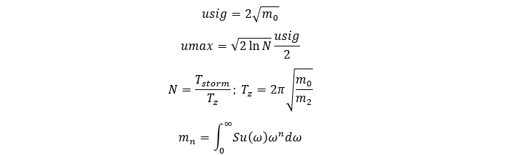
Load Case Matrix Review
Strength Analysis| Vessel/RAO screening
Vessel Spectral Response Analysis (to reduce the load case matrix)
Input is Hs-Tp’s, wave directions, vessel RAO (different drafts) and hang off location (s)
3 hour spectral response of
Hang off max/min acceleration
Hang off max/min angular motion
Identifies:
Worst hang off location
Governing loading condition (ballast, intermediate, full load)
Governing wave peak period Tp (Tp=+/-10%)
Governing wave headings relative to vessel
The screening will reduce the load case matrix from many combinations to a limited set of load cases

Slide 16
Load Case Matrix Review
Strength Analysis| Vessel/RAO screening
Wave Critical Time Window Screening
100sec window selection (from a 3 hour wave realization)
Window 1: Highest vertical acceleration at hang-off
Window 2: Highest hang-off angle
Repeated for 5 wave realizations
Full irregular extreme analysis
Full irregular extreme analysis will be performed with the riser on the reduced set of load cases for the critical 100s window
With hang off point fixed; the load case combination is reduced

Slide 17
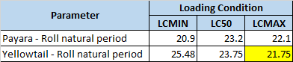
Load Case Matrix Review
Results| Vessel/RAO screening
UMB-1, From RAO/wave screening, critical wave direction is:
Max Tension/Acceleration cases: 60deg and 75deg from bow (from North)
Max Curvature/Rotation cases: 60deg, 75deg and 90deg (from North)
Ballast Condition governing for Max Tension/Acceleration
100 year Acceleration goes from 2.17 in Payara to 2.25m/s2.
100 year Rotation goes from 8.5 in Payara to 9.3deg.

Slide 18
Load Case Matrix Review
Results| Vessel/RAO screening

Slide 19
Load Case Matrix Review
Results| Vessel/RAO screening
Screening UMB-1 versus UMB-5:
Similar vertical acceleration at hang off
Slightly more acceleration for UMB-1
Same rotation response

Slide 20
Load Case Matrix Review
Results| Vessel/RAO screening
Screening UMB-1 YellowTail versus UMB-1 Payara:
Larger acceleration response for YellowTail
Rotation for 100yr and 1000 yr return period are larger than Payara

Slide 21
Strength / Extreme Results
Results| Strength
Results are presented for one seed.
Max tension – 1080 kN observed for 1000-year Survival (100-year wave , Intact, FAR Offset of 6% W.D), Aker max tension = unknown
MBR at bend stiffener – 36m observed for 100-year Abnormal condition (100-year wave, 1-Fail, Cross offset 8% W.D), Aker MBR= unknown
Max Strain in bend stiffener – 7.12% observed for 1000-year Survival condition (1000-year wave, Intact, Cross offset 6% W.D)
Buoyancy Region
Min Tension – -9 kN observed for 1000-year Survival case(Offset in transverse direction). Compression also observed in 10-year wave case as well.
No compression observed in TDP region.
ID | Load Case | Mooring Condition | FPSO Hull Condition | Bend Stiffener Region |  |  |  |  | Min Tension - Buoyancy Region
 |  |  |  | Max Tension | Asso. MBR | MBR | Assoc. Tension | Max Bend Stiff Strain
 |  |  |  | [ kN ] | [m] | [m] | [ kN ] | [%] | [ kN ]
ID-01 | Extreme-10 Year | Intact | Intact | 996 | 79 | 87 | 616 | 2.65 | 0.0
ID-02 | Extreme-100 Year | Intact | Intact | 994 | 79 | 69 | 638 | 4.59 | 1.4
ID-03 | Abnormal - 1Year | Intact | Heel +/- 10º | 948 | 79 | 41 | 815 | 2.46 | 3.5
ID-04 | Abnormal - 10 Year | Intact | Heel +/- 6º | 999 | 79 | 38 | 815 | 3.63 | -0.1
ID-05 | Abnormal - 100 Year | 1 line fail | Intact | 1011 | 77 | 36 | 815 | 5.96 | 0.8
ID-06 | Survival - 1000 Year | Intact | Intact | 1080 | 77 | 59 | 638 | 7.12 | -9.0
ID-07 | Hydrotest - 1 Year | Intact | Intact | 944 | 79 | 111 | 625 | 1.58 | 3.7

Slide 22
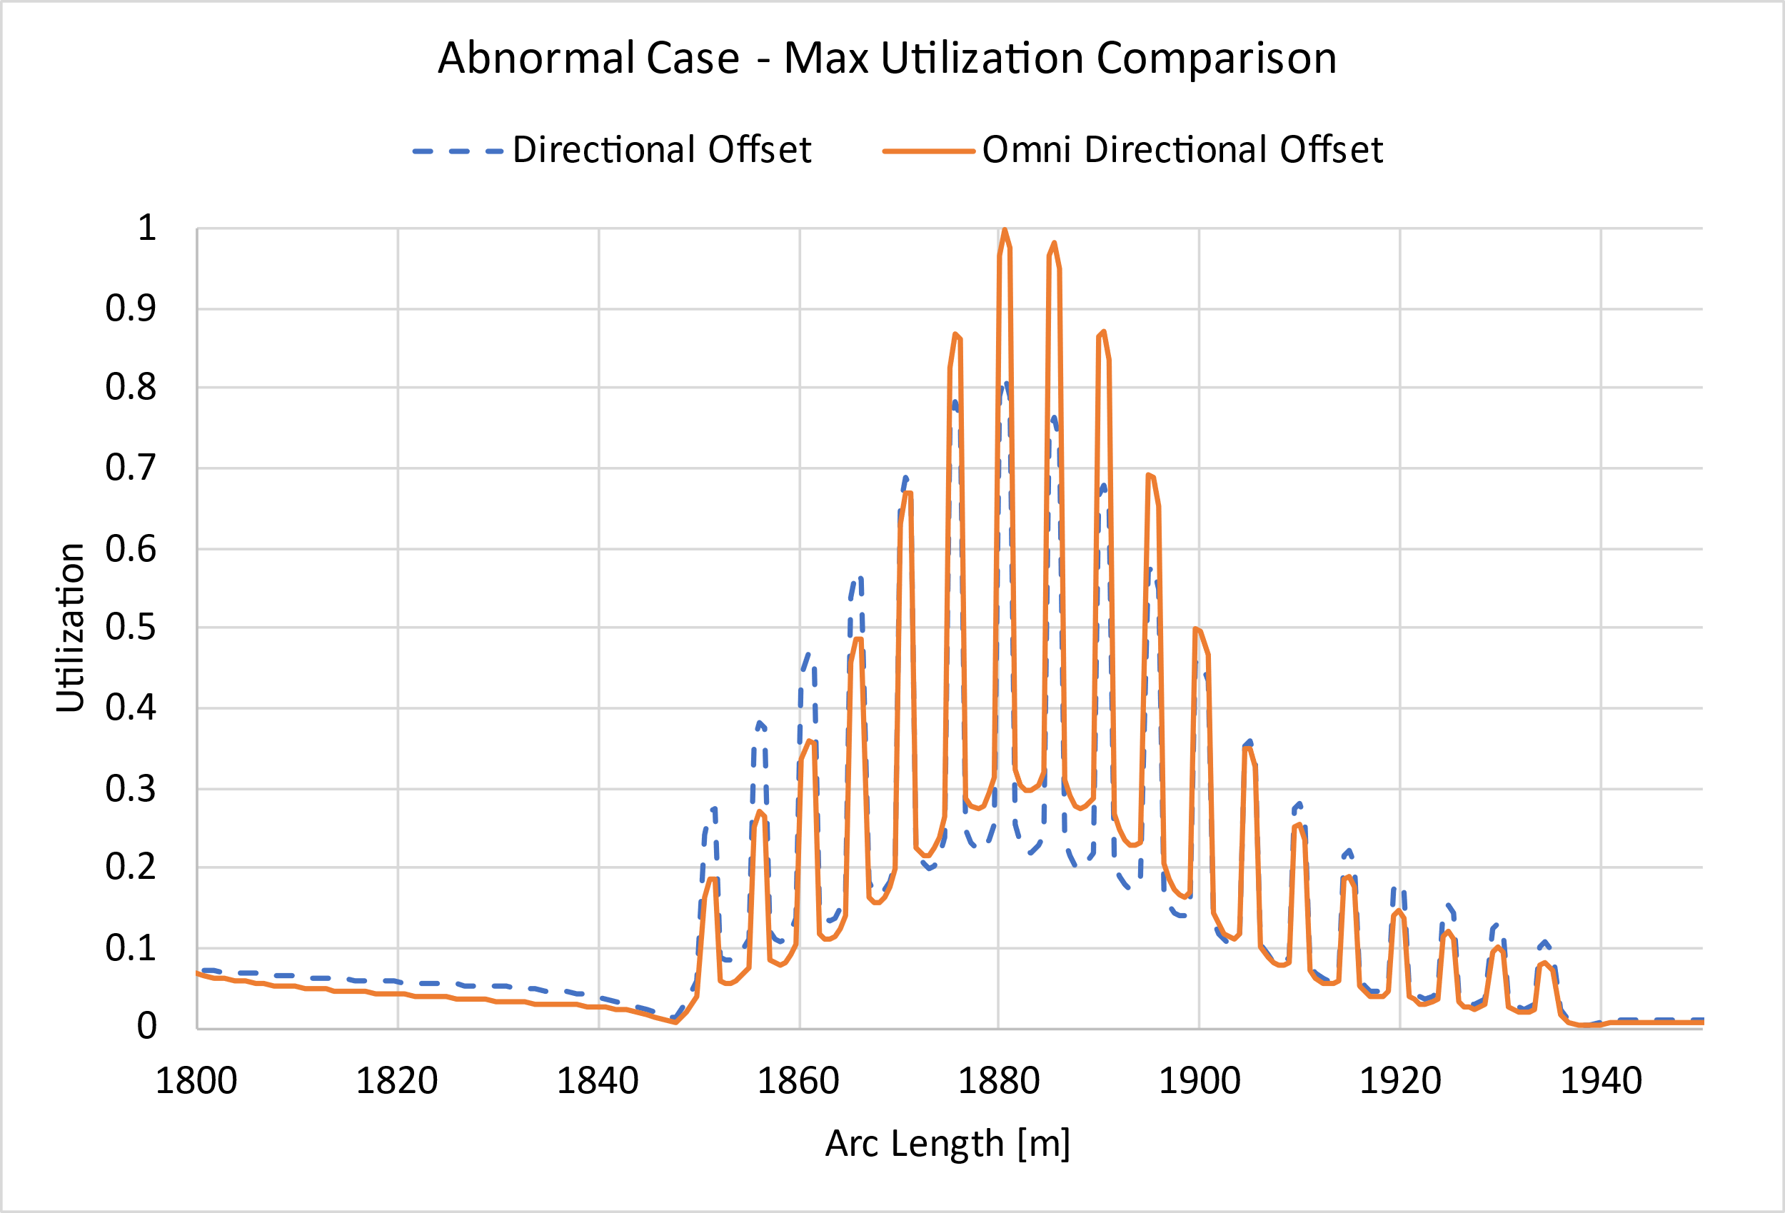
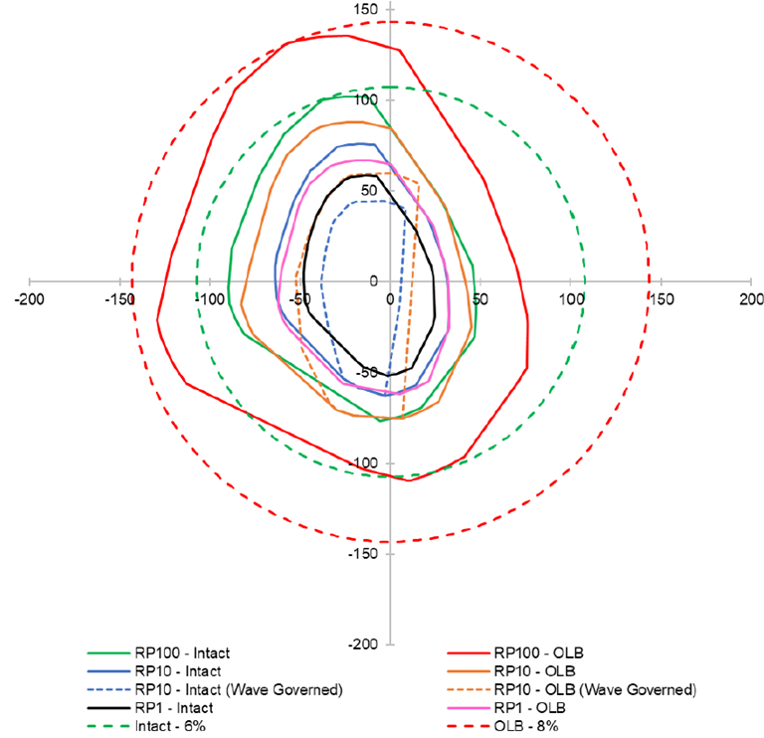
Strength / Extreme Results
Results| Strength
Results are presented for one seed.
Max utilization are observed always in the Buoyancy region. Lower buoyancy compared to Payara.
For Abnormal case with omnidirectional offset of 8% Utilization is very close to the limit for a Near Case
Using directional offset lowers the utilization to 0.82 from 0.997.
ID | Load Case | Vessel Offset | Mooring Condition | FPSO Hull Condition | Utilization |  |  | Allowable Utilization
 |  |  |  |  | Bend Stiffener | Buoyancy Region | TDP Region
ID-01 | Extreme-10 Year | 6% WD | Intact | Intact | 0.31 | 0.72 | 0.13 | 0.80
ID-02 | Extreme-100 Year | 6% WD | Intact | Intact | 0.38 | 0.72 | 0.12 | 0.80
ID-03 | Abnormal - 1Year | 6% WD | Intact | Heel +/- 10º | 0.47 | 0.87 | 0.04 | 1.00
ID-04 | Abnormal - 10 Year | 6% WD | Intact | Heel +/- 6º | 0.51 | 0.90 | 0.05 | 1.00
ID-05 | Abnormal - 100 Year | 8% WD | 1 line fail | Intact | 0.56 | 0.9975 | 0.06 | 1.00
ID-06 | Survival - 1000 Year | 6% WD | Intact | Intact | 0.35 | 0.95 | 0.07 | 1.00
ID-07 | Hydrotest - 1 Year | 6% WD | Intact | Intact | 0.29 | 0.83 | 0.13 | 0.96

Slide 23
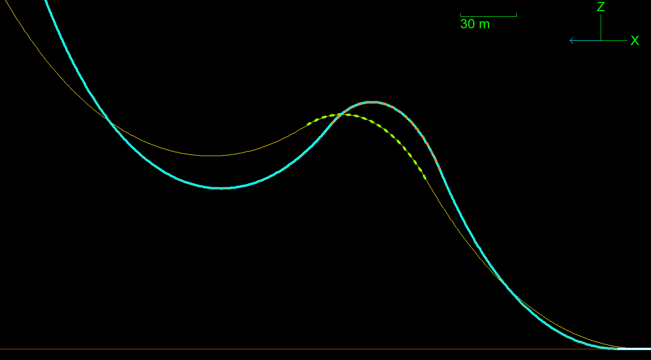
Strength / Extreme Results
Results| Strength
NOMINAL POSITION VERSUS 6% OFFSET
LOW MBR IN HOG SECTION

Slide 24
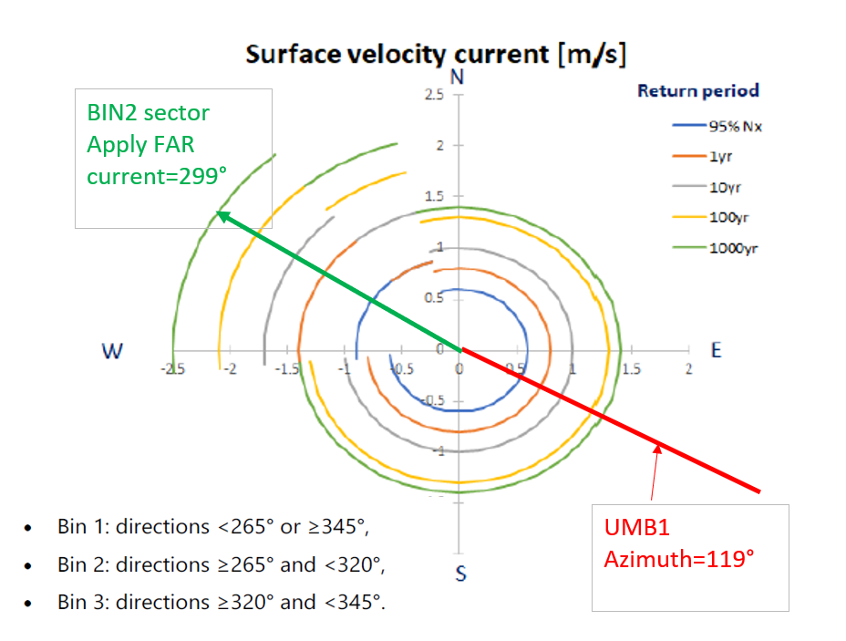
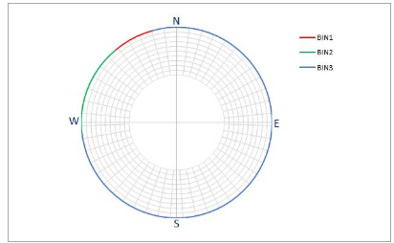
Strength / Extreme Results
Directional offset and current
Omni directional offset 107m (6%) or 143m (8%)
Note using directional offsets:
Intact NEAR offset: 60m (10yr) and 70m (100yr)
Damage NEAR offset: 70m (10yr) and 100m (100yr)
70m versus 107m gives around 0.1 improvement in utilization (ref. previous slide)
Directional current
Worst Current in FAR direction
10% added to current (+200m)
Dir | Profile | Met Ocean | Bin #
16 | NE100 | 74 | Bin1
196 | SW100 | 254 | Bin1
61 | N100 | 29 | Bin1
331 | W100 | 119 | Bin1
241 | S100 | 209 | Bin1
151 | E100 | 299 | Bin2
106 | NW100 | 344 | Bin3
286 | SE100 | 164 | Bin1

Slide 25
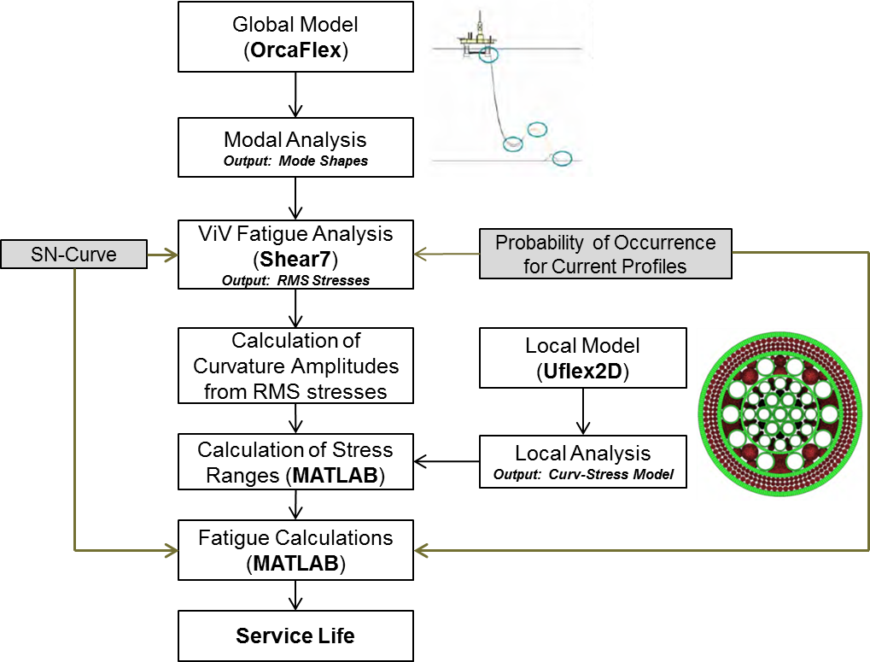
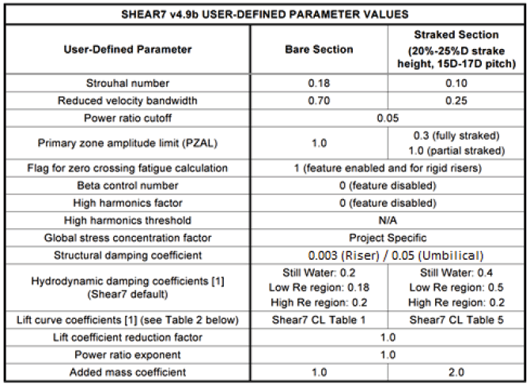
VIV Methodology
Shear7 v4.9b
Combined with Uflex
Inline and transvers

Slide 26
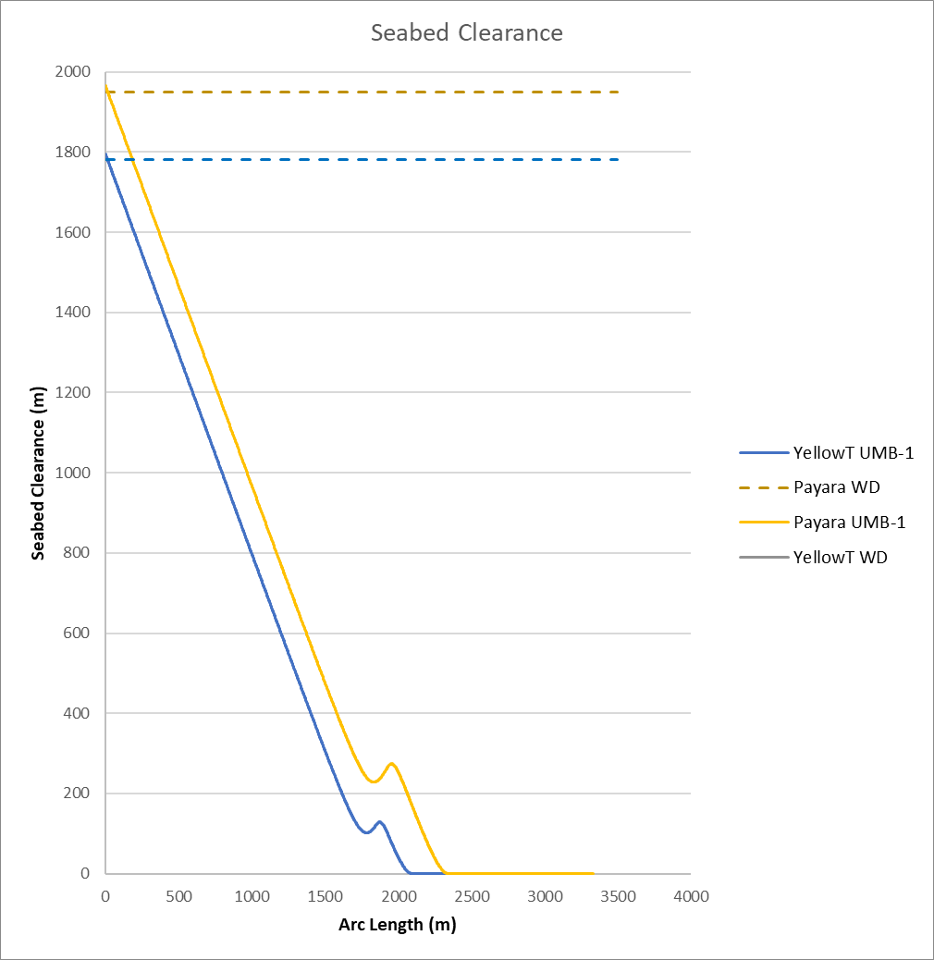
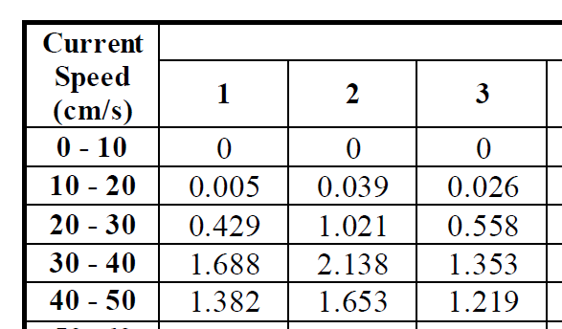
VIV updates
Updates in Yellowtail
Some updates in input compared to Payara project
Main change is:
Mean current speed in each bin instead of upper value
Lower buoyancy
 | Yellow Tail | Payara
Water Depth (m) | 1780 | 1950
Buoyancy Coverage Length (m) | 145 | 86.07
Sag/Hog to seabed (m) | 103/120 | 231/268
UMB-1 Top 100m Bending Stiffness (kN.m^2) | 206 | 260
Seabed Friction coefficient (Lateral/Axia) | 0.49/0.25 this is close to Aker's value | 0.6/0.41
VIV Current | mean current speed | upper current speed
Resonance observed in VIV? | No | Yes, main damage comes from one/two current profiles

Slide 27
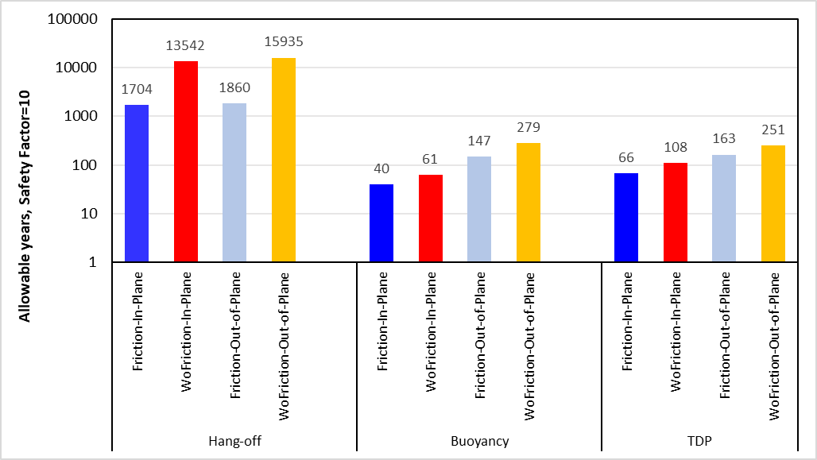
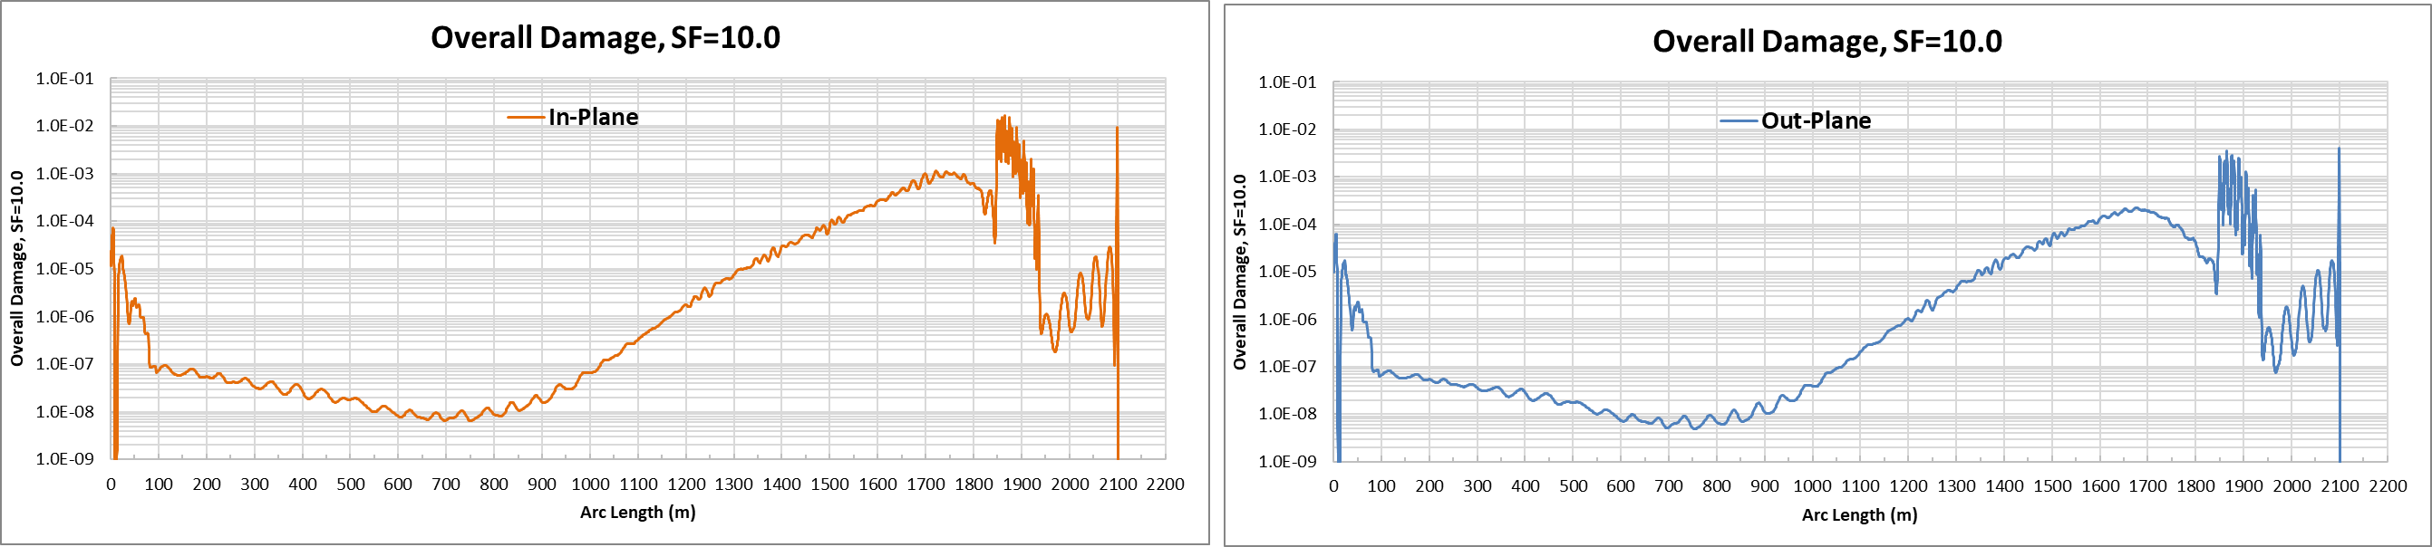
VIV Results
Results| Long Term VIV
46 current profiles and 439 load cases Current in In-Plane and Out of Plane direction
Buoyancy section is modelled as a discrete type
The results are factored with a S.F=10
With and without friction effects
Hang off: 1704 years
HOG: 40 years
TDP: 66 years

Slide 28
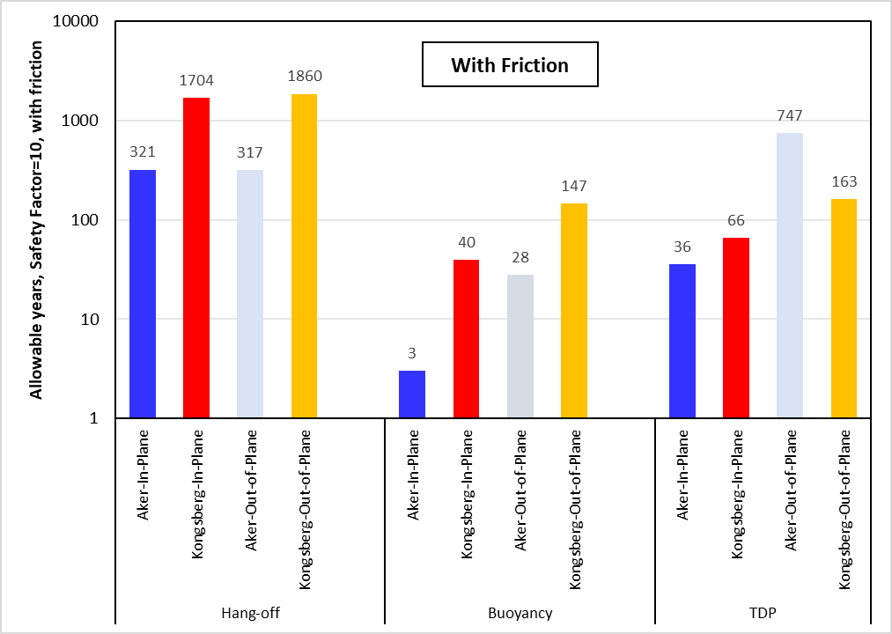
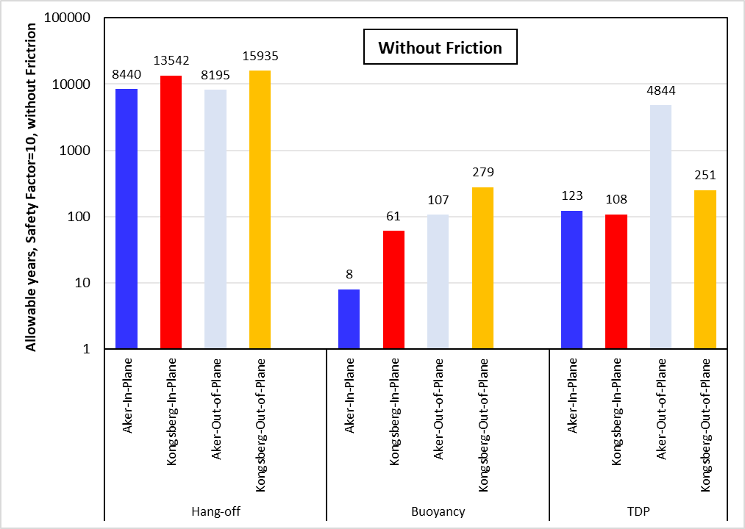
VIV Results – comparison with Aker
Results| Long Term VIV
With friction:
Hang off: 5 times higher life than Aker
HOG: 13 times higher life than Aker (3years versus 40 years)
TDP: 2 times higher life than Aker
Without friction:
Hang off: 1.5-2.0 times higher life than Aker
HOG: 8 times higher life than Aker
TDP: Similar life

Slide 29
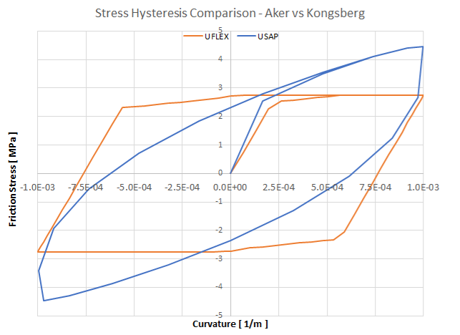
VIV Results – comparison with Aker

Slide 30
Combined Fatigue
Local Analysis| Results
Wave fatigue to be performed
Parameter | Parameter | BS |  | HOG |  | TDP
 |  | Aker | Kongsberg | Aker | Kongsberg | Aker | Kongsberg
Wave Fatigue | Wave Fatigue Damage
 | Wave Fatigue years life (incl DFF=10) [Years]
 | Arc Length for hot spot [m]
VIV Fatigue | VIV Fatigue Damage | 3.15E-04 | 5.87E-05 | 3.29E-02 | 2.53E-03 | 2.81E-03 | 6.14E-04
 | VIV Fatigue years life (incl DFF=10) [Years] | 317 | 1704 | 3 | 40 | 36 | 66
 | Arc Length for hot spot [m]
Combined years life

Slide 31
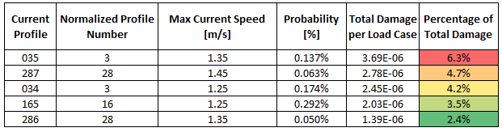
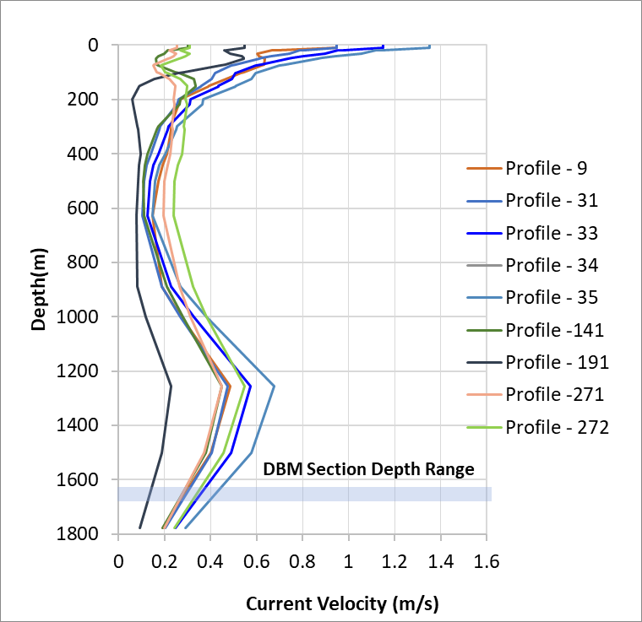
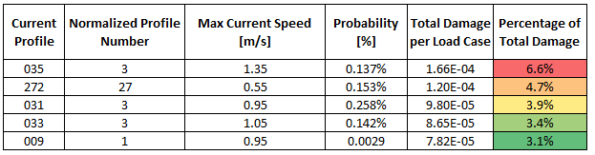
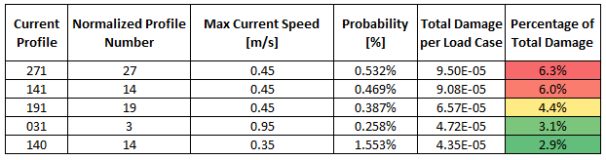
VIV Results
Results| Long Term VIV
Out-of-plane case
Normalized profile 3 causes more damage in all regions
Current profile 33 has highest current speed among all current profiles
The results are unfactored and with friction effects
Hang-off
Sag-Hog
TDP

Slide 32
BACKUP SLIDES

Slide 33
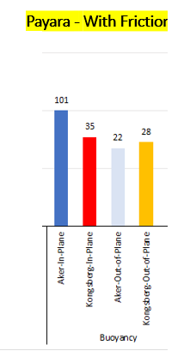
VIV Results – comparison with Payara
Results| Long Term VIV
 | Yellow Tail | Payara
Water Depth (m) | 1780 | 1950
Buoyancy Coverage Length (m) | 145 | 86.07
Sag/Hog to seabed (m) | 103/120 | 231/268
UMB-1 Top 100m Bending Stiffness (kN.m^2) | 206 | 260
Seabed Friction coefficient (Lateral/Axia) | 0.49/0.25 this is close to Aker's value | 0.6/0.41
VIV Current | V2 with mean current speed | V1 with upper current speed
Resonance observed in VIV? | No | Yes, main damage comes from one/two current profiles

Slide 34
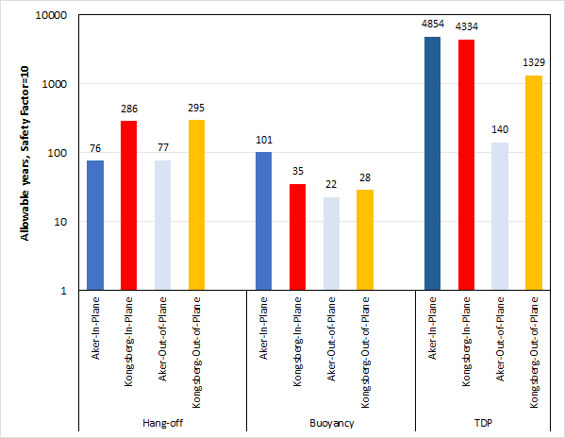
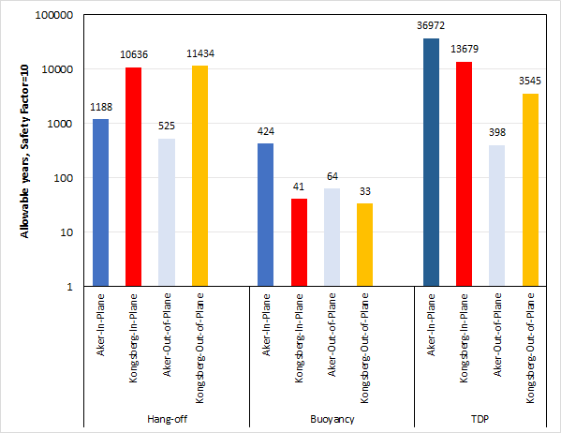
VIV Results – Payara (PAST)
Results| Long Term VIV
Payara – W/o Friction
Payara - With Friction

